Slide 1
HR ANALYSIS

Slide 2
1.Questions to Answer
2.Approach and Analysis
3.Distribution
4.Yearly hires and terminations
5.Termination Rates
6.Results
Contents

Slide 3
Approach and Analysis
Downloaded the dataset from Kaggle.
Imported the dataset file into a MySQL database.
Cleaned the fields and made necessary alterations in the table structure.
Developed and executed SQL queries to analyse the data.
Extracted the analysed data from the MySQL database.
Exported the resulting dataset to Power BI.
Use Power BI to create visualizations and dashboards based on the analysed HR data.
Presented the findings and insights from the analysis through the visualizations created in Power BI.

Slide 4
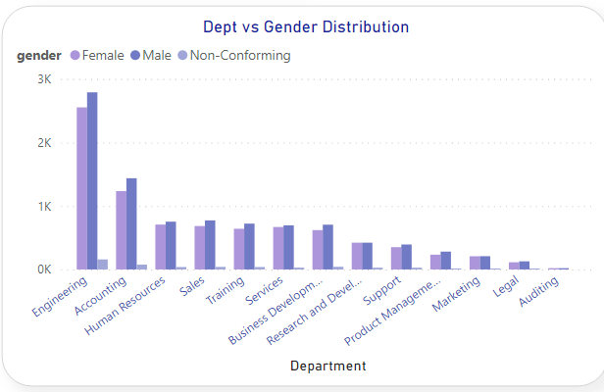
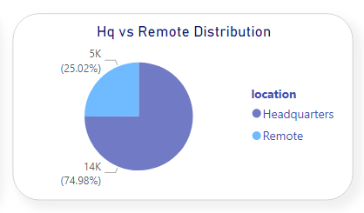
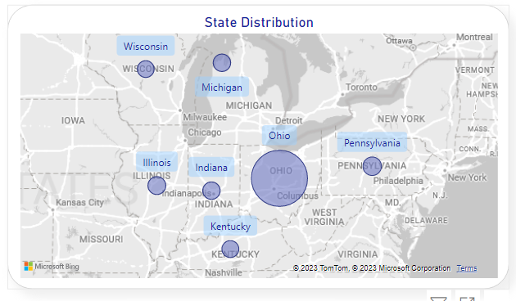
Distribution
By Distribution we can do surveys to get the idea of remote working like it does affect the other factors or not like employee wellness and productivity etc.
Most probably Male has more contribution overall in the organization of employment ratio followed by females

Slide 5
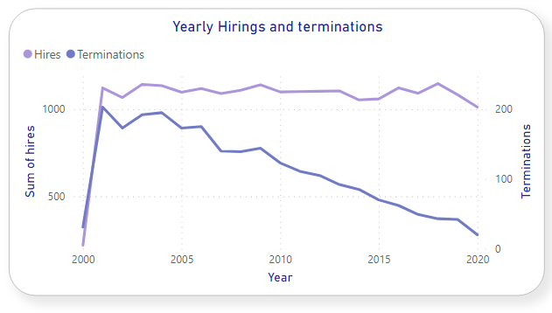
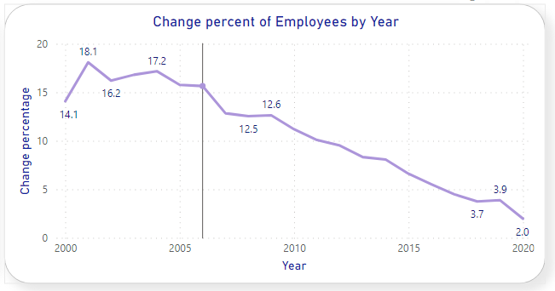
Yearly Terminations
By passing year termination rate is decreased over the time and hirings remain constant over the years which is a good sign of employee satisfaction over the organization.

Slide 6
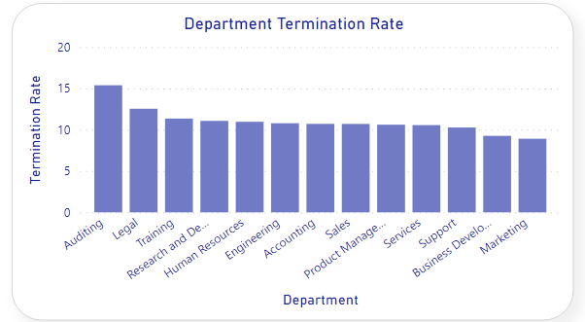
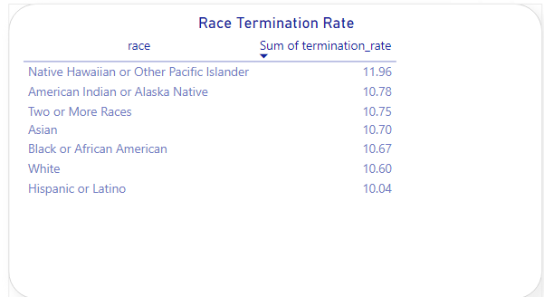
Termination Rate
Termination rate is higher in auditing followed by legal department and the race which has least contribution of employment which has higher termination rate, we can implement diversity inclusion initiatives to ensure all have equal support also, by identifying the specific issue concerned by departments we can decrease rate and fix it.

Slide 7
Insights
We can conduct the employee surveys to assess the satisfaction and productivity of those who working remotely to get the idea whether it affect the other factors or not.
By analysing performance and engagement levels of different age group we can develop training and development programs to ensure continuous growth.
We can promote diversity and inclusion initiatives to create a more equitable work environment through different races.
By the decrease in termination rates and stable hiring rates over the years we can refine the Hr strategies which have contributed to these trends.
By age group exits we can offer career development and mentorship programs to retain experienced talent and support career progression for employees in their late 30s.
Also, to improve the retention rate department wise we can address the specific issue in department.
As we have seen there is higher termination rates among American Indian and Native Hawaiian employees, we can implement diversity and inclusion initiatives to ensure all employees have equal opportunities and support.

Slide 8
Thank You

